Slide 1
Buttons

Slide 2
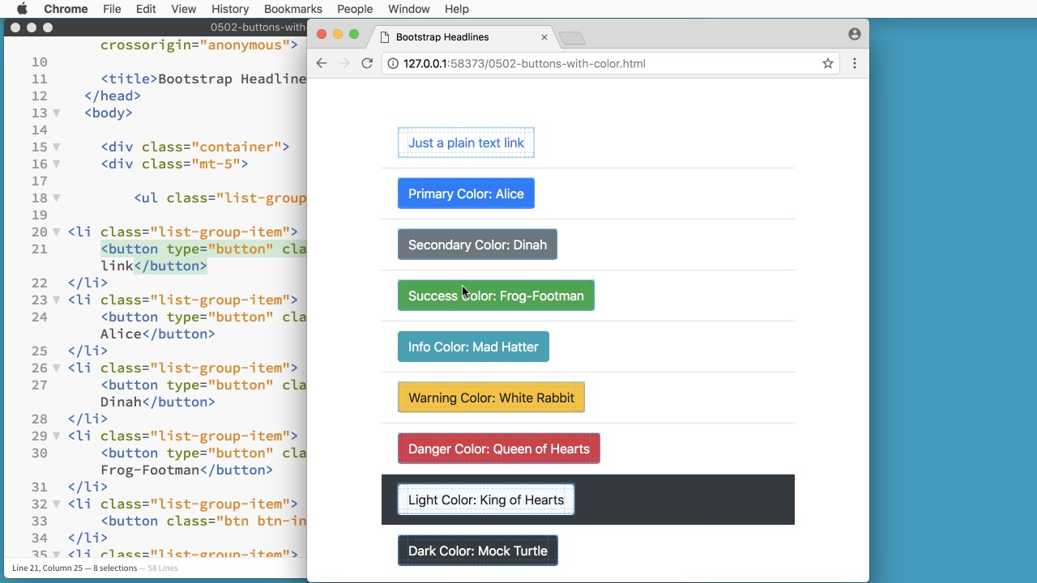

Slide 3
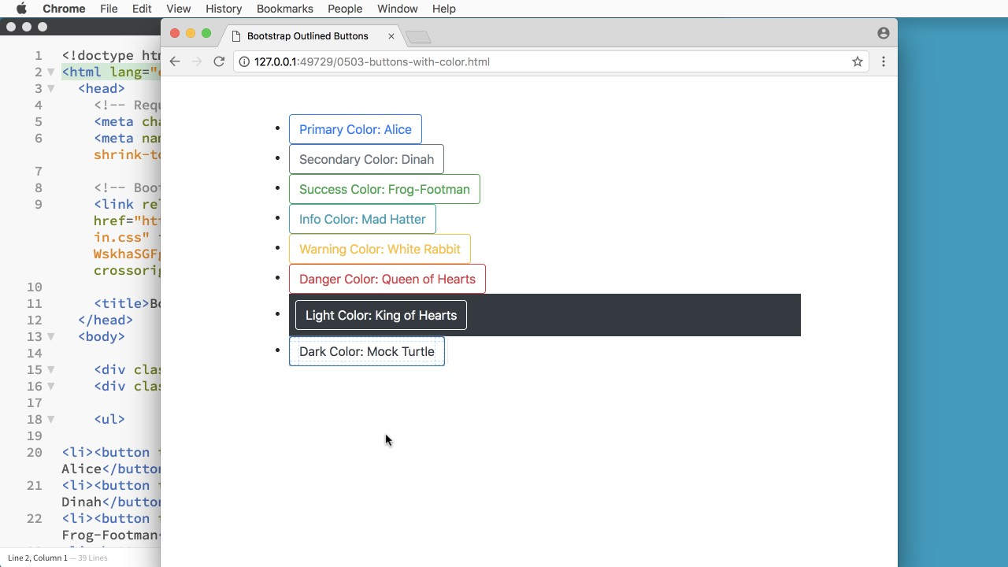

Slide 4
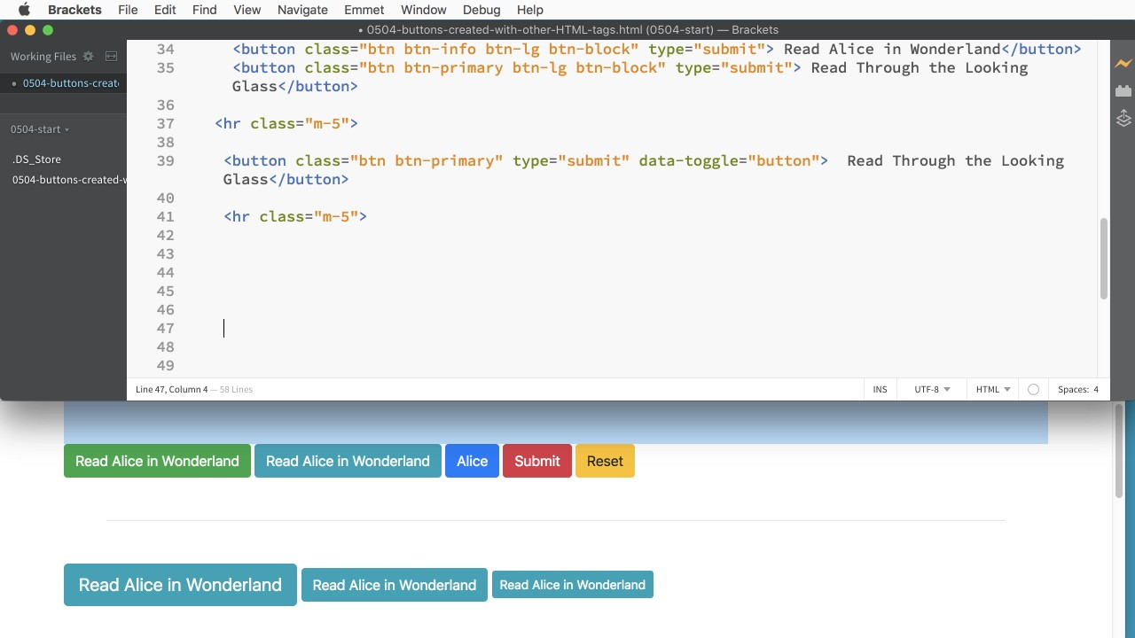

Slide 5
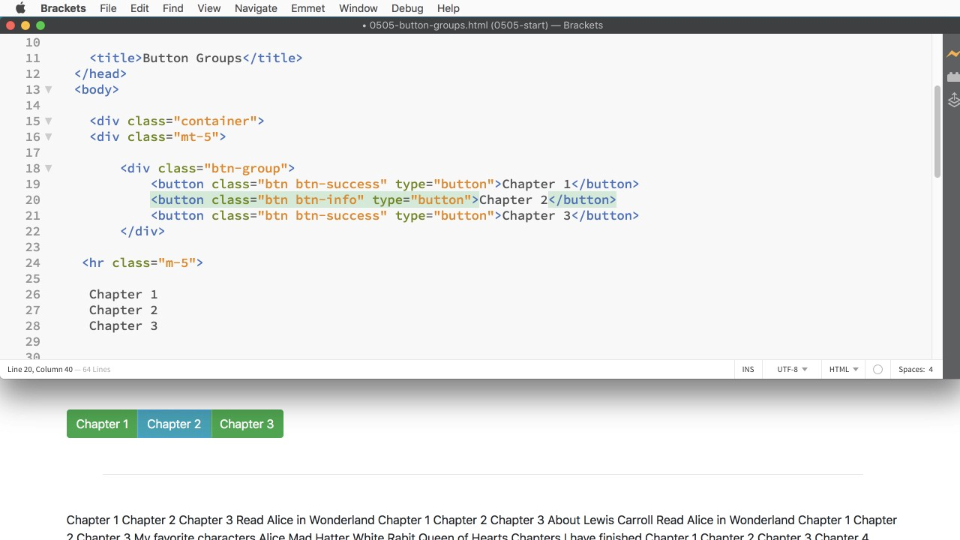

Slide 6
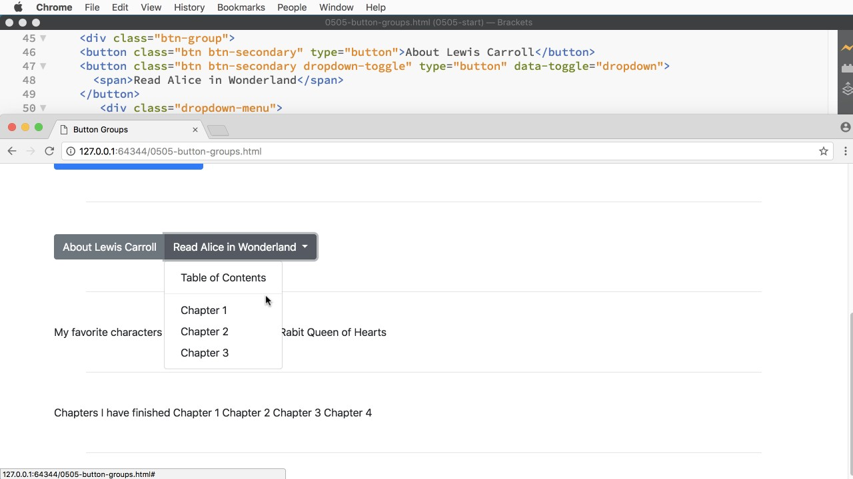

Slide 7
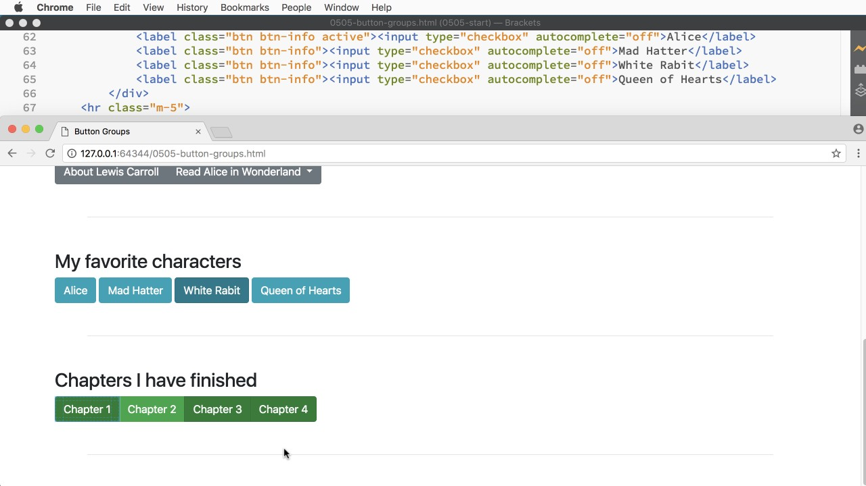

Slide 8
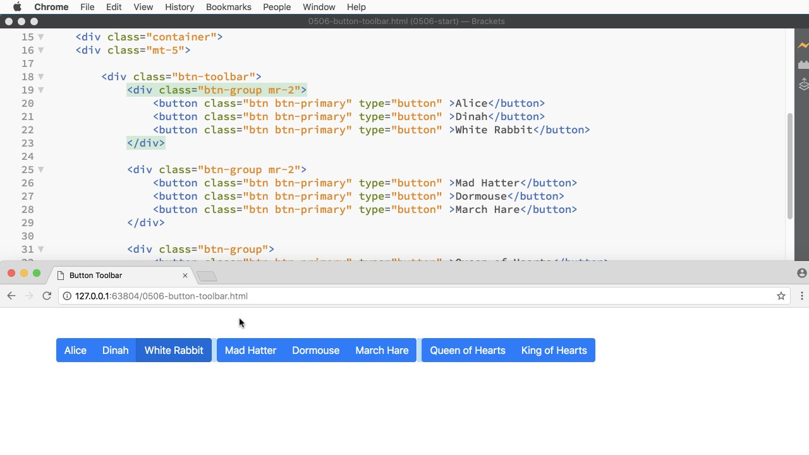

Slide 9
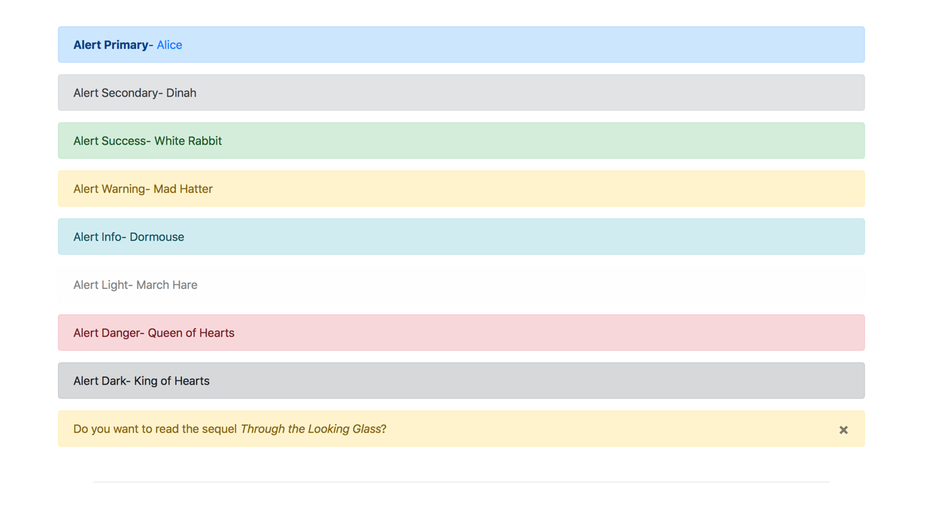

Slide 10
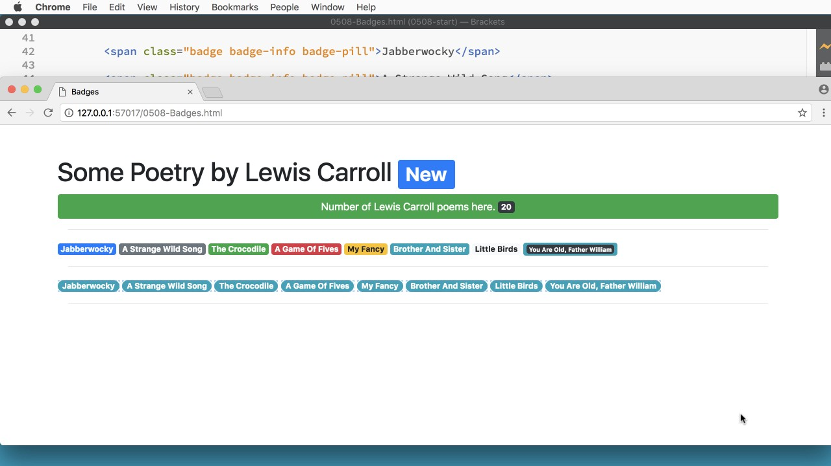

Slide 11
Let's get started.

Slide 12
Summary

Slide 13
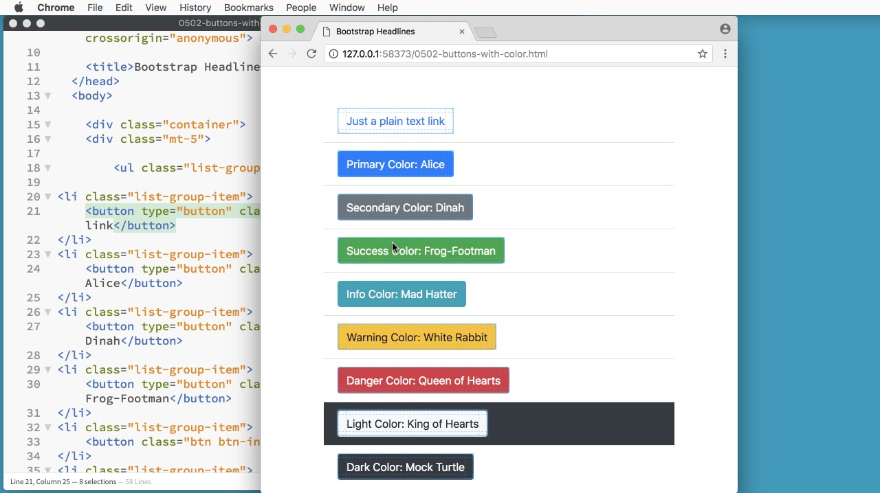
Summary

Slide 14

Summary

Slide 15

Summary

Slide 16

Summary

Slide 17

Summary

Slide 18

Summary

Slide 19
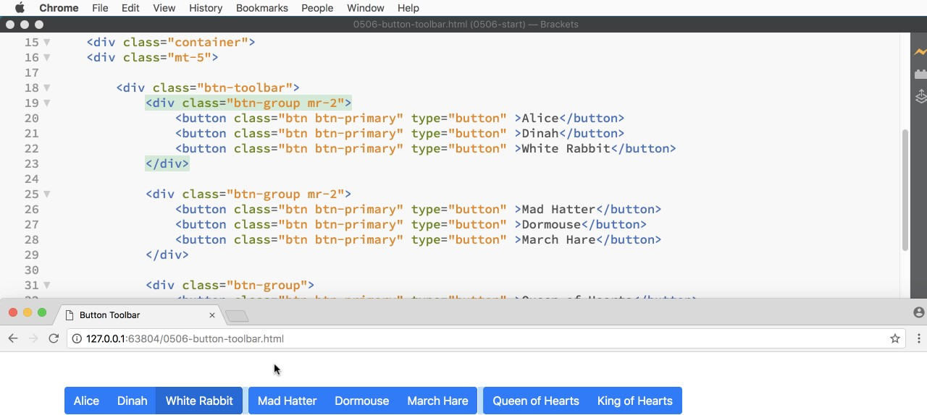
Summary

Slide 20
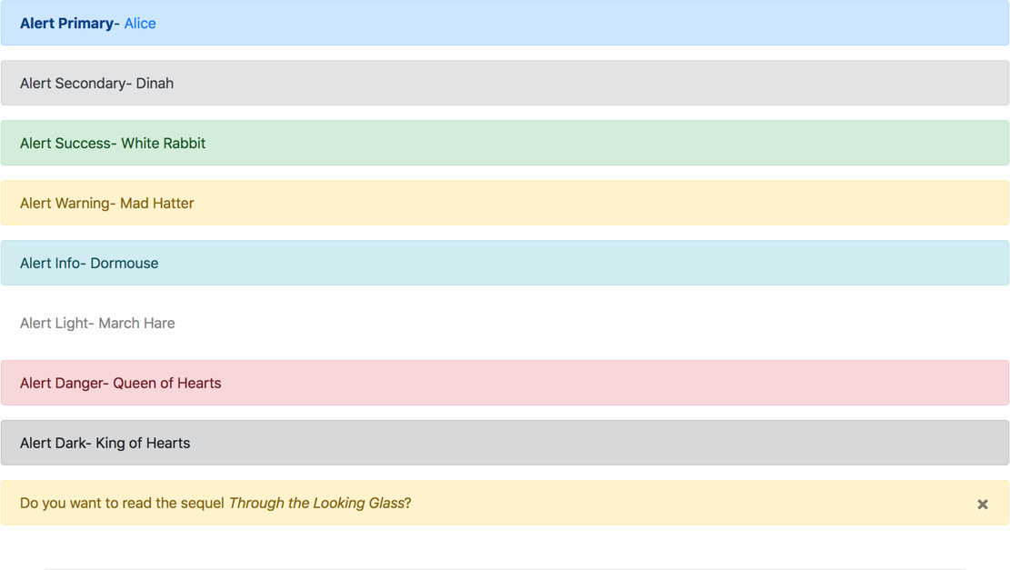
Summary

Slide 21

Summary

Slide 22


